Slide 1




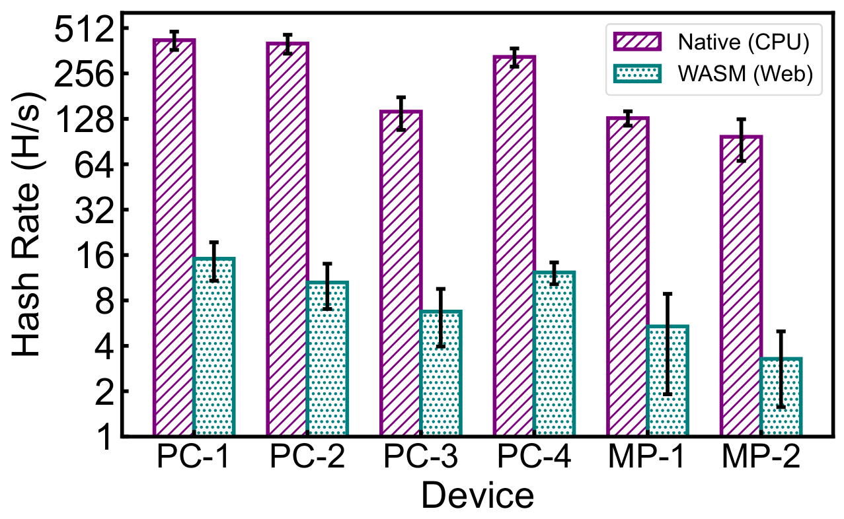
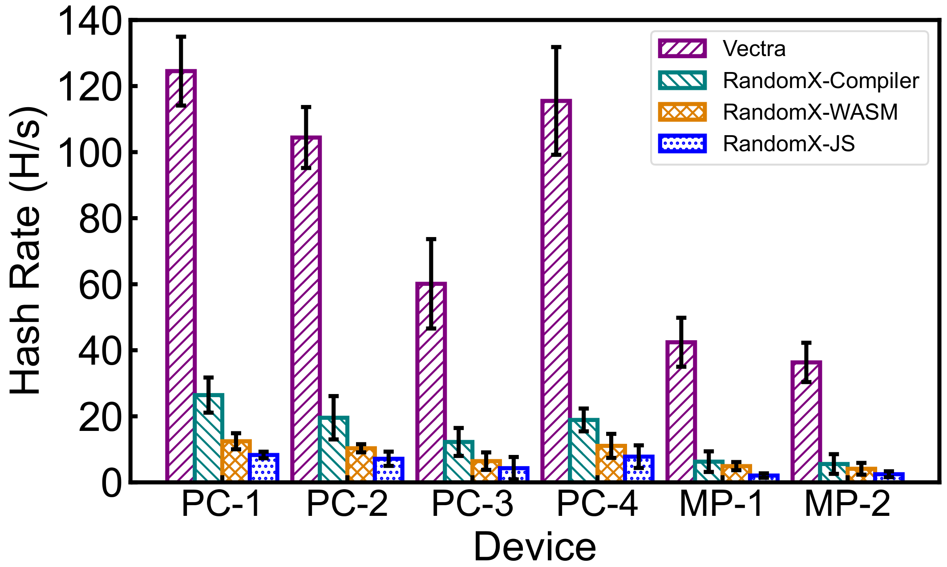
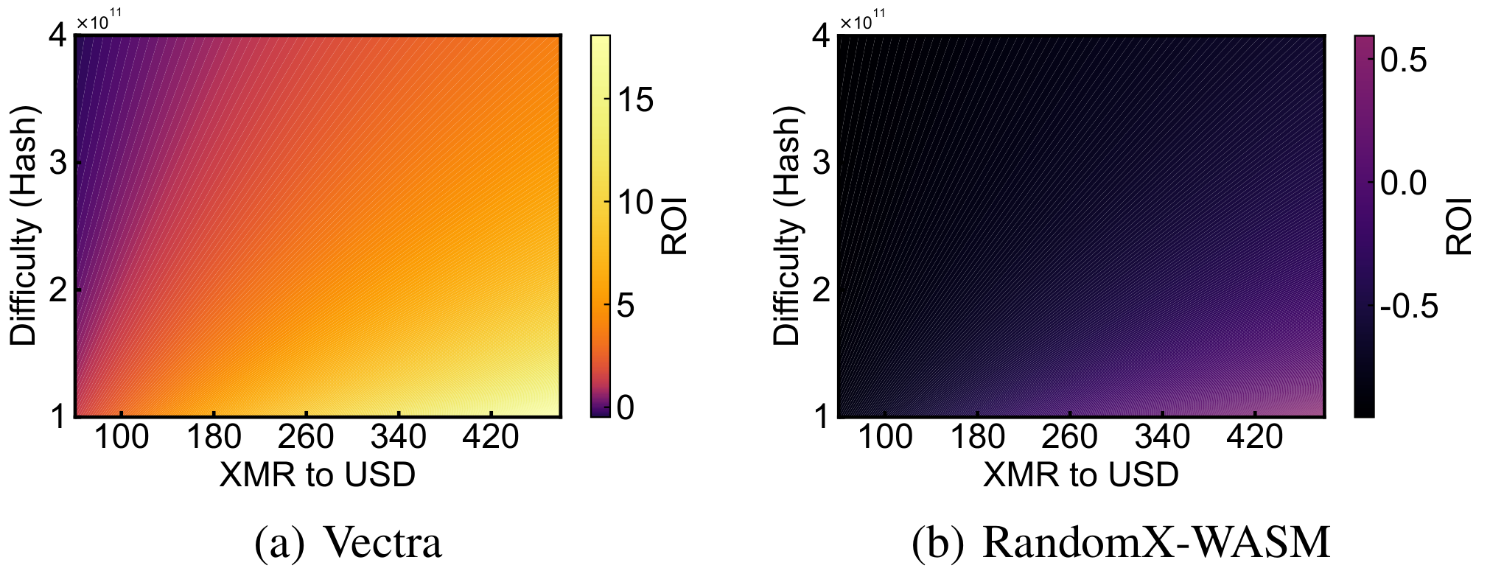

Democratizing the Cryptocurrency Ecosystem by
Just-In-Time Transformation of Mining Programs
Wei Liu, Zhenhua Li, Feng Qian, Feiyu Jin, Hao Lin, Yannan Zheng, Bo Xiao, Xiaokang Qin, Tianyin Xu
New mining algorithms (e.g., RandomX) for combating dedicated mining hardware (e.g., ASICs) have impaired the performance of web-based mining
The democracy of the cryptocurrency ecosystem has not been fully recovered
Key insight: Tracking data element propagations of mining algorithms for efficient SIMD execution over the web
Vectra: Fast web cryptomining based on element propagation
graph modeling for just-in-time optimizations of mining instructions
7X reductions on emulated WASM instructions
3X-16X faster at mining Monero under diverse browser execution environments
64%~274% return-on-investment (ROI) for users
Code and data are publicly available at
https://github.com/WebCryptomining
Contact us at liuwei199803@gmail.com for more details

